Slide 1
MIRAI
The Real Zombie Infection

Slide 2
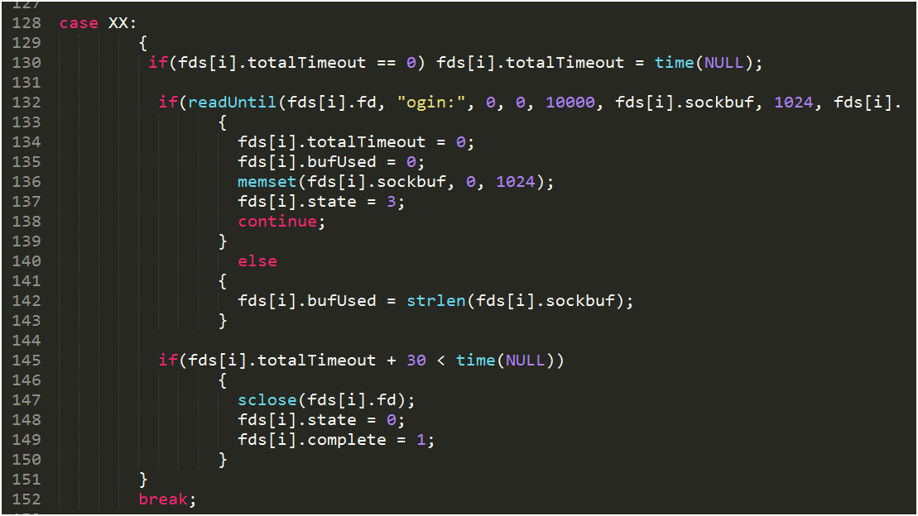
The Technicals
Mirai was written in C and Go.
It was originally created by Paras Jha and Josiah White.
Created to attack machines running Linux based operating systems specifically those that ran on ARC processors.
Operates on a Command and Control structure.
Some estimates state that at its peak Mirai had infected over 600 thousand IoT devices.

Slide 3
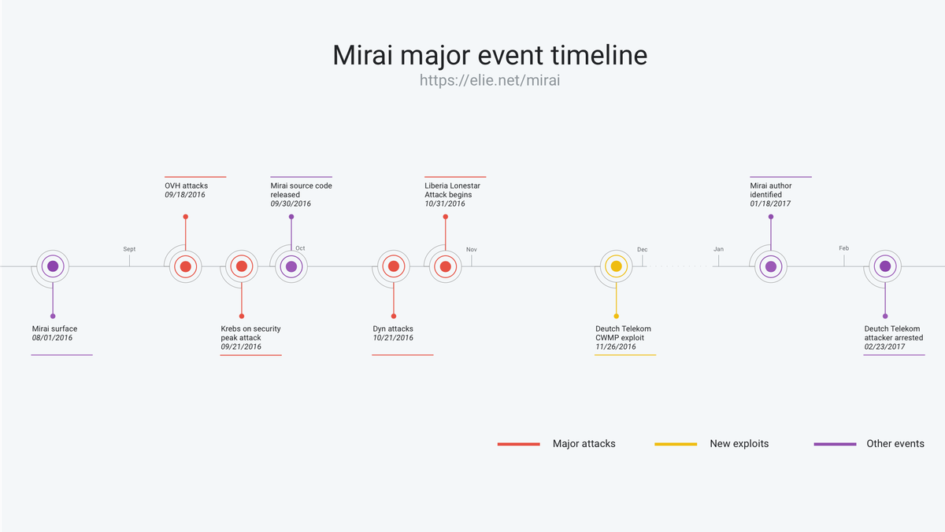
Why Was Mirai So Effective
Mirai, and its successors, are partly so effective because they target smart devices that can connect to the internet IoTs. Once infected the devices, which can be anything from a security camera to a smart fridge, will connect to a central hub and wait for commands. Usually one of the first commands received is an automated one that tells the system to search for more vulnerable systems thus spreading the malware.

Slide 4


